Slide 1
A Cellular Model for Road Traffic
Wojciech Kania
Harry lipscomb

Slide 2
Theory
Cellular Automata Introduction
Traffic Flow Curves
Road Density

Slide 3
Model
4 Key Stages:
Acceleration Phase
Slowing Down Phase
Random Brake Phrase
Moving Phase
Double Lane Extension
Funnelling Lane Variation

Slide 4
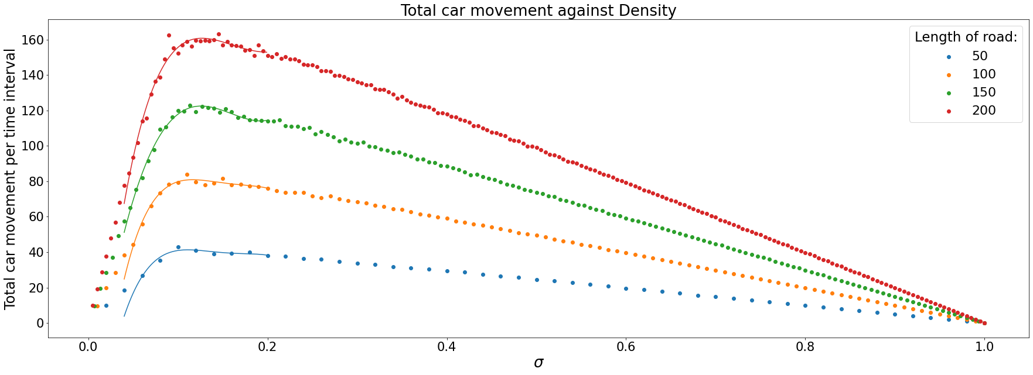
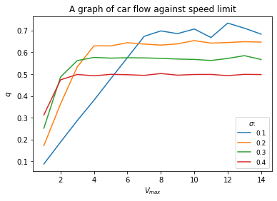
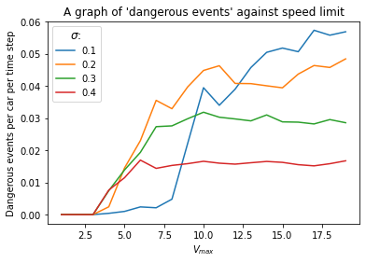
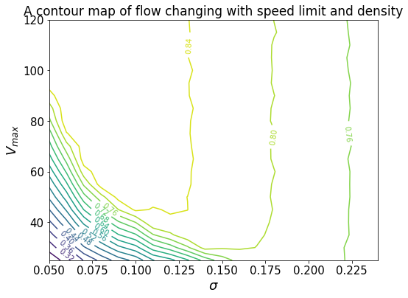
Single Lane Results
Optimum Speed Limits Found:
σ = 0.1: Speed Limit: 56mph to 44mph
σ = 0.3 to 0.4: Speed Limit: 28mph to 22mph

Slide 5
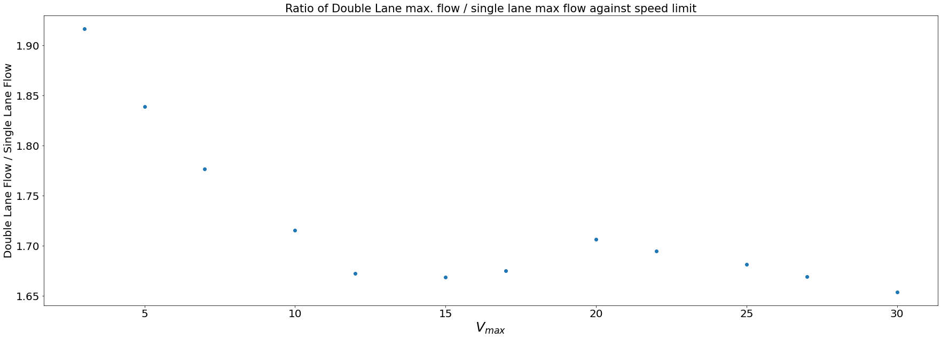
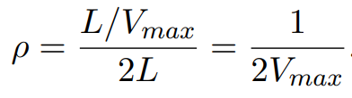
Double Lane and Funnel Lane Results
Insert funnelling lane graphs here.
The improvement in traffic flow was a factor of 1.92 to 1.65 times greater, speed limit dependant.
Equilibrium density (in the funnelling lane) was found to follow

Slide 6
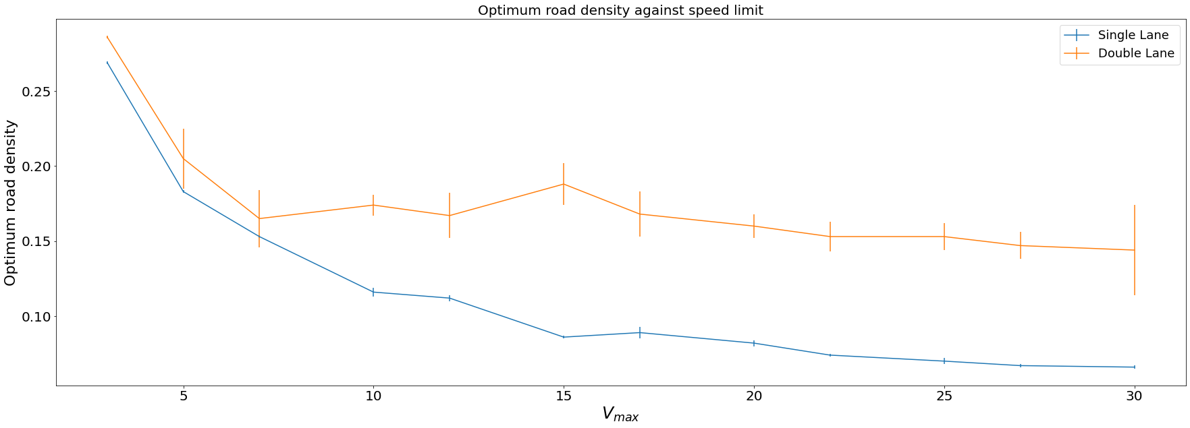
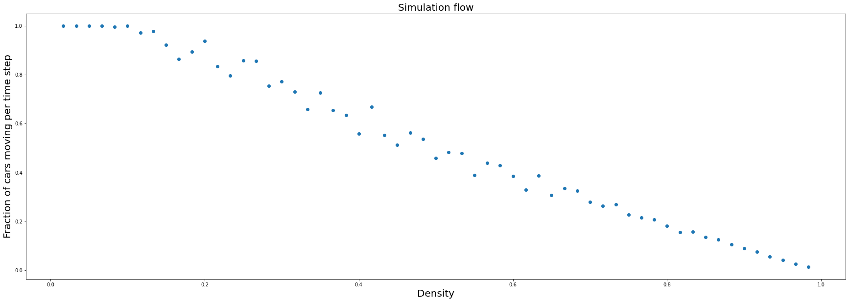
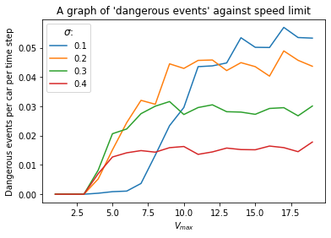
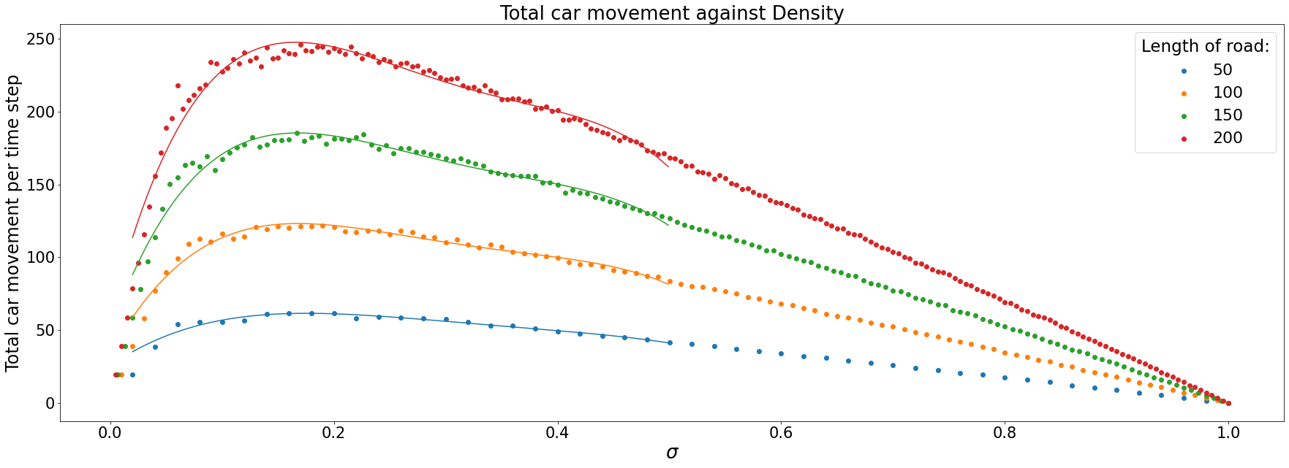
Extra Results Found
(Bottom graphs are double lane)

